Slide 1
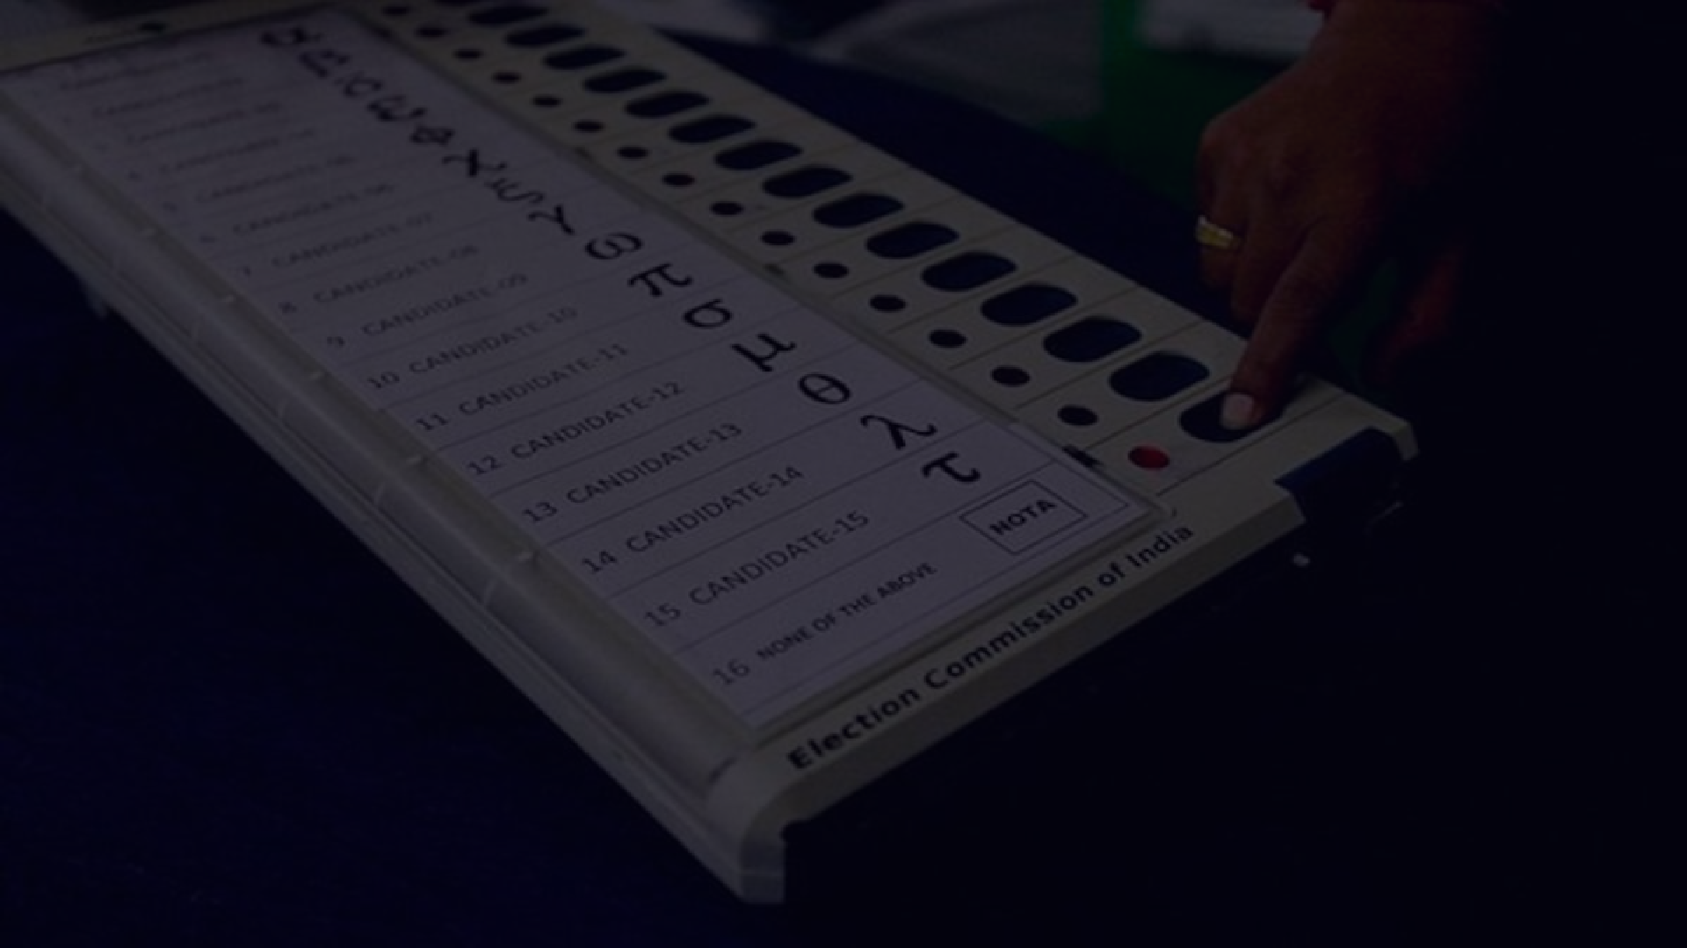
Security and Privacy Concerns about Electronic Voting
PRESENTATION ON
PRESENTED BY:-
UDIT GUPTA NEHA SAXENA SPARSH JAIN

Slide 2
INTRODUCTION
01 | Electronic voting systems have gained significant popularity in recent years due to their potential to enhance the voting process.
02 | However, along with their benefits, there are inherent security and privacy concerns that need to be addressed.
03 | We will discuss potential threats and vulnerabilities that can compromise the accuracy, transparency, and privacy of the voting process.

Slide 3
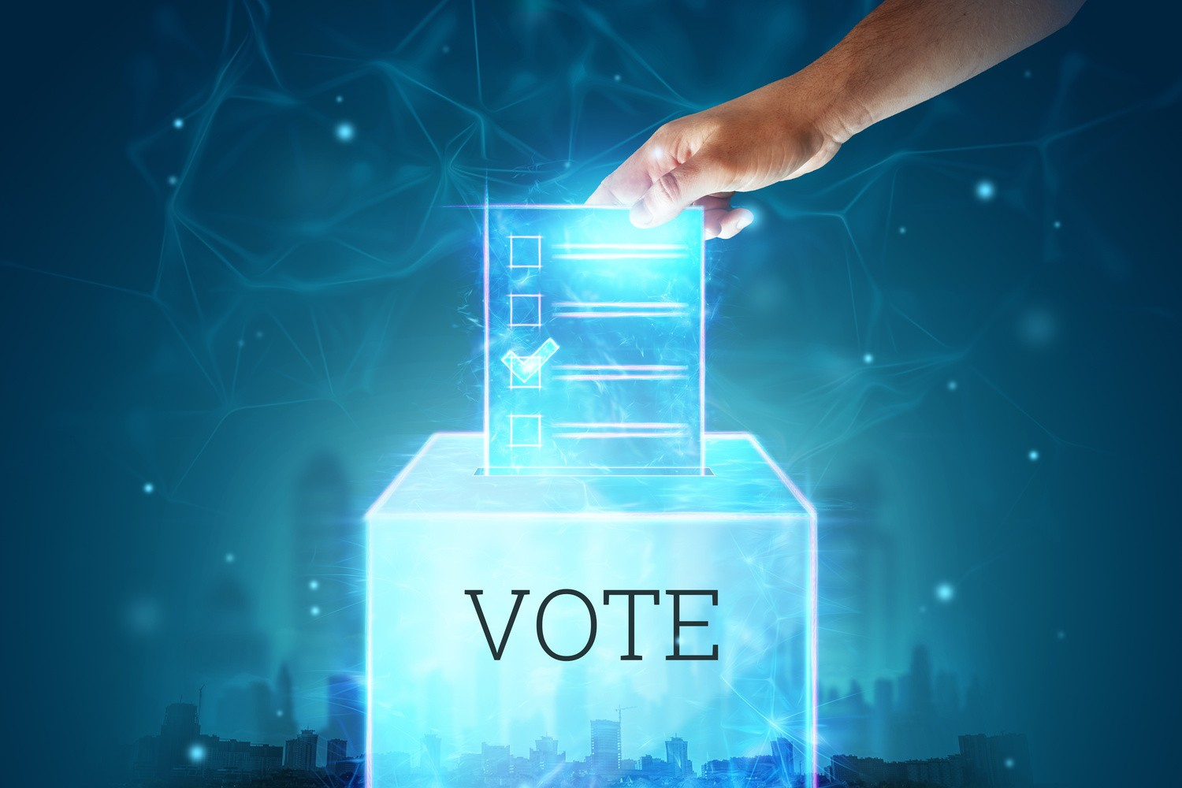
Overview of Electronic Voting
What is Electronic Voting?
Electronic voting, also known as e- voting, refers to the use of electronic systems and technology to facilitate the casting and counting of votes in elections.
Advantages of Electronic Voting
Increased accessibility
Enhanced efficiency
Improved accuracy

Slide 4


Security Concerns
Common security concerns include:
Security breaches can lead to:
Hacking
Tampering
Insider Attack
Compromised election results, affecting the legitimacy of the democratic process.
Loss of public trust and confidence in the electoral system.
Potential legal and political implications, leading to challenges and disputes over election outcomes.

Slide 5
Privacy Concerns
Key privacy concerns include:
Compromised privacy can result in:
Collection of voter data
Anonymity
Voter identification
Voter profiling and targeted political advertising based on collected data
Coercion or intimidation of voters due to the potential disclosure of voting preferences
Distrust and skepticism among voters regarding the protection of their personal information.

Slide 6



Enhancing Security in Electronic Voting
Encryption
Secure Transmission Protocols Audit Trails
Ensuring Privacy in Electronic Voting:
Privacy by Design
Anonymization Techniques
Access Control and Data Protection

Slide 7

CONCLUSION
Addressing security and privacy concerns in electronic voting is crucial for maintaining the integrity and trustworthiness of elections.
Robust security measures, encryption, secure transmission protocols, and audit trails are essential for protecting the voting process.

